Slide 1
WEEK 5
Process Environment and Process Control

Slide 2
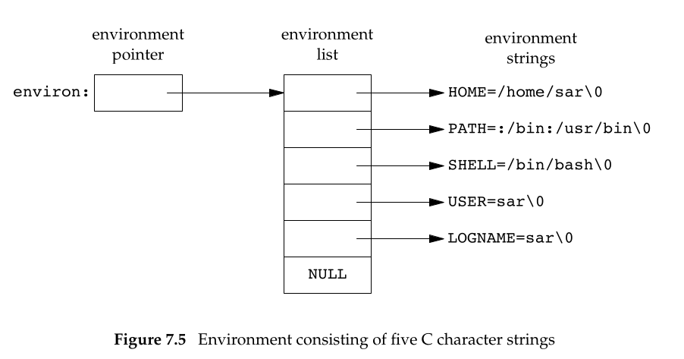
Environment List
Each program is passed with an environment list.
Environment list is an array of character pointers, with each pointer containing the address of a null-terminated C string.
The address of the array of pointers is contained in the global variable environ:
extern char **environ;

Slide 3
Environment List
Each program is passed with an environment list.
Environment list is an array of character pointers, with each pointer containing the address of a null-terminated C string.
The address of the array of pointers is contained in the global variable environ:
extern char **environ;

Slide 4
Environment List
For example, if the environment consisted of five strings
By convention, the environment consists of strings
name=value
In Terminal Command Prompt : env
Most predefined names are entirely uppercase

Slide 5
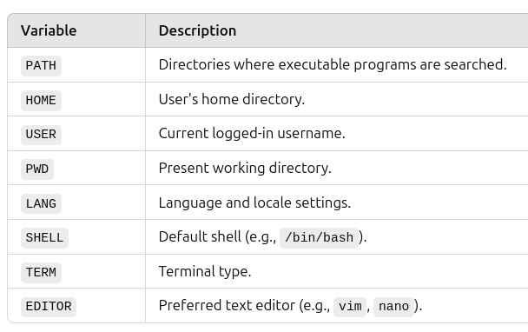
Environment Variables
Common Environment Variables
Typically, a default Unix shell session has 50 to 100 environment variables, but in complex systems with many applications and configurations, the count can be much higher.

Slide 6
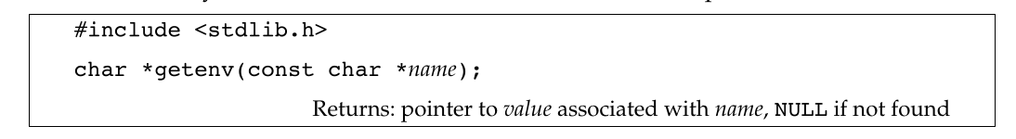
Environment variables
The shell use numerous environment variables.
Environment variables are dynamic values that define the operating environment for processes in an operating system.
Use getenv to fetch a specific value from the environment, instead of accessing environ directly.

Slide 7
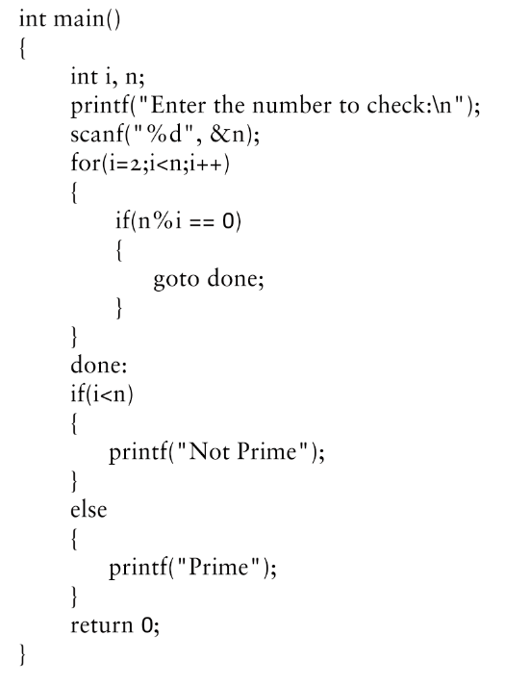
setjmp and longjmp Functions
In C, we can’t goto a label that’s in another function.
Instead, we must use the setjmp and longjmp functions to perform this type of branching.

Slide 8
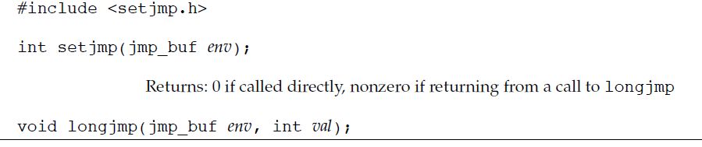
setjmp and longjmp Functions
The solution to this problem is to use a nonlocal goto: the setjmp and longjmp functions.
setjmp returns 0, when we called it directly.
In the call to setjmp, the argument env is of the special type jmp_buf. This data type is some form of array that is capable of holding all the information required to restore the status of the stack to the state when we call longjmp.

Slide 9
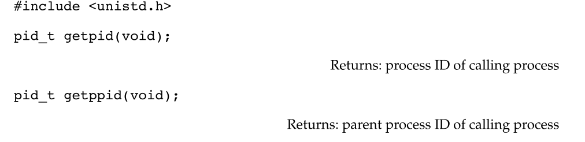
Process Identifiers
Every process has a unique process ID, a non-negative integer.
Process ID 0 is usually the scheduler process and is often known as the swapper.
Process ID 1 is usually the init process and is invoked by the kernel at the end of the bootstrap procedure.
Process ID 2 is the pagedaemon. This process is responsible for supporting the paging of the virtual memory system.

Slide 10
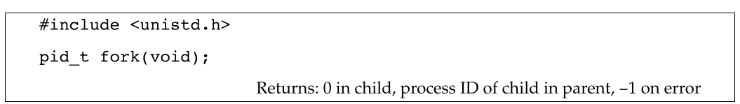
fork Function
An existing process can create a new one by calling the fork function.
The new process created by fork is called the child process. This function is called once but returns twice. The only difference in the returns is that the return value in the child is 0, whereas the return value in the parent is the process ID of the new child.
The reason the child’s process ID is returned to the parent is that a process can have more than one child, and there is no function that allows a process to obtain the process IDs of its children.
The reason fork returns 0 to the child is that a process can have only a single parent, and the child can always call getppid to obtain the process ID of its parent.

Slide 11
vfork Function
The vfork function was intended to create a new process for the purpose of executing a new program
The vfork function creates the new process, just like fork, without copying the address space of the parent into the child, as the child won’t reference that address space; the child simply calls exec (or exit) right after the vfork.
vfork guarantees that the child runs first, until the child calls exec or exit. When the child calls either of these functions, the parent resumes.

Slide 12
exit Functions
A process can terminate normally in five ways:
Executing a return from the main function.
Calling the exit function.
Calling the _exit or _Exit function.
Executing a return from the start routine of the last thread in the process.
Calling the pthread_exit function from the last thread in the process.

Slide 13
exit Functions
The three forms of abnormal termination are as follows
1. Calling abort. This is a special case of the next item, as it generates the
SIGABRT signal.
2.When the process receives certain signals. The signal can be generated by the process itself (e.g., by calling the abort function), by some other process, or by the kernel.
3. The last thread responds to a cancellation request.
Another condition we have to worry about is when a child terminates before its parent.
If the child completely disappeared, the parent wouldn’t be able to fetch its termination status when and if the parent was finally ready to check if the child had terminated.
The kernel keeps a small amount of information for every terminating process, so that the information is available when the parent of the terminating process calls wait or waitpid.
Minimally, this information consists of the process ID, the termination status of the process, and the amount of CPU time taken by the process.

Slide 14
wait and waitpid Functions
When a process terminates, either normally or abnormally, the kernel notifies the parent by sending the SIGCHLD signal to the parent.
Because the termination of a child is an asynchronous event—it can happen at any time while the parent is running — this signal is the asynchronous notification from the kernel to the parent.
The parent can choose to ignore this signal, or it can provide a function that is called when the signal occurs: a signal handler. The default action for this signal is to be ignored.

Slide 15
wait and waitpid Functions
For now, we need to be aware that a process that calls
wait or waitpid can
Block, if all of its children are still running
Return immediately with the termination status of a child, if a child has terminated and is waiting for its termination status to be fetched
Return immediately with an error, if it doesn’t have any child processes

Slide 16
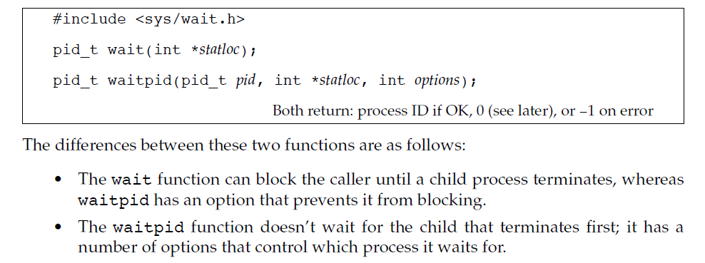
wait and waitpid Functions
If the process is calling wait because it received the SIGCHLD signal, we expect wait to return immediately.
But if we call it at any random point in time, it can block.

Slide 17
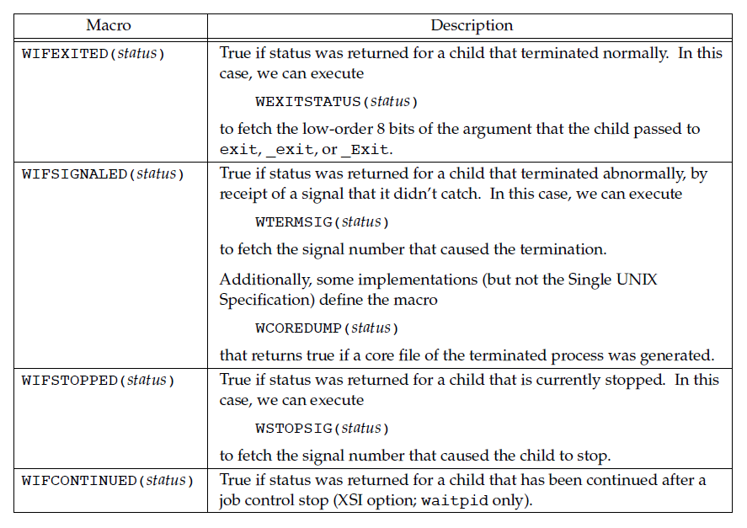
wait and waitpid Functions
Four mutually exclusive macros tell us how the process terminated, and they all begin with WIF.
The four mutually exclusive macros are

Slide 18
THANK YOU

